Slide 1
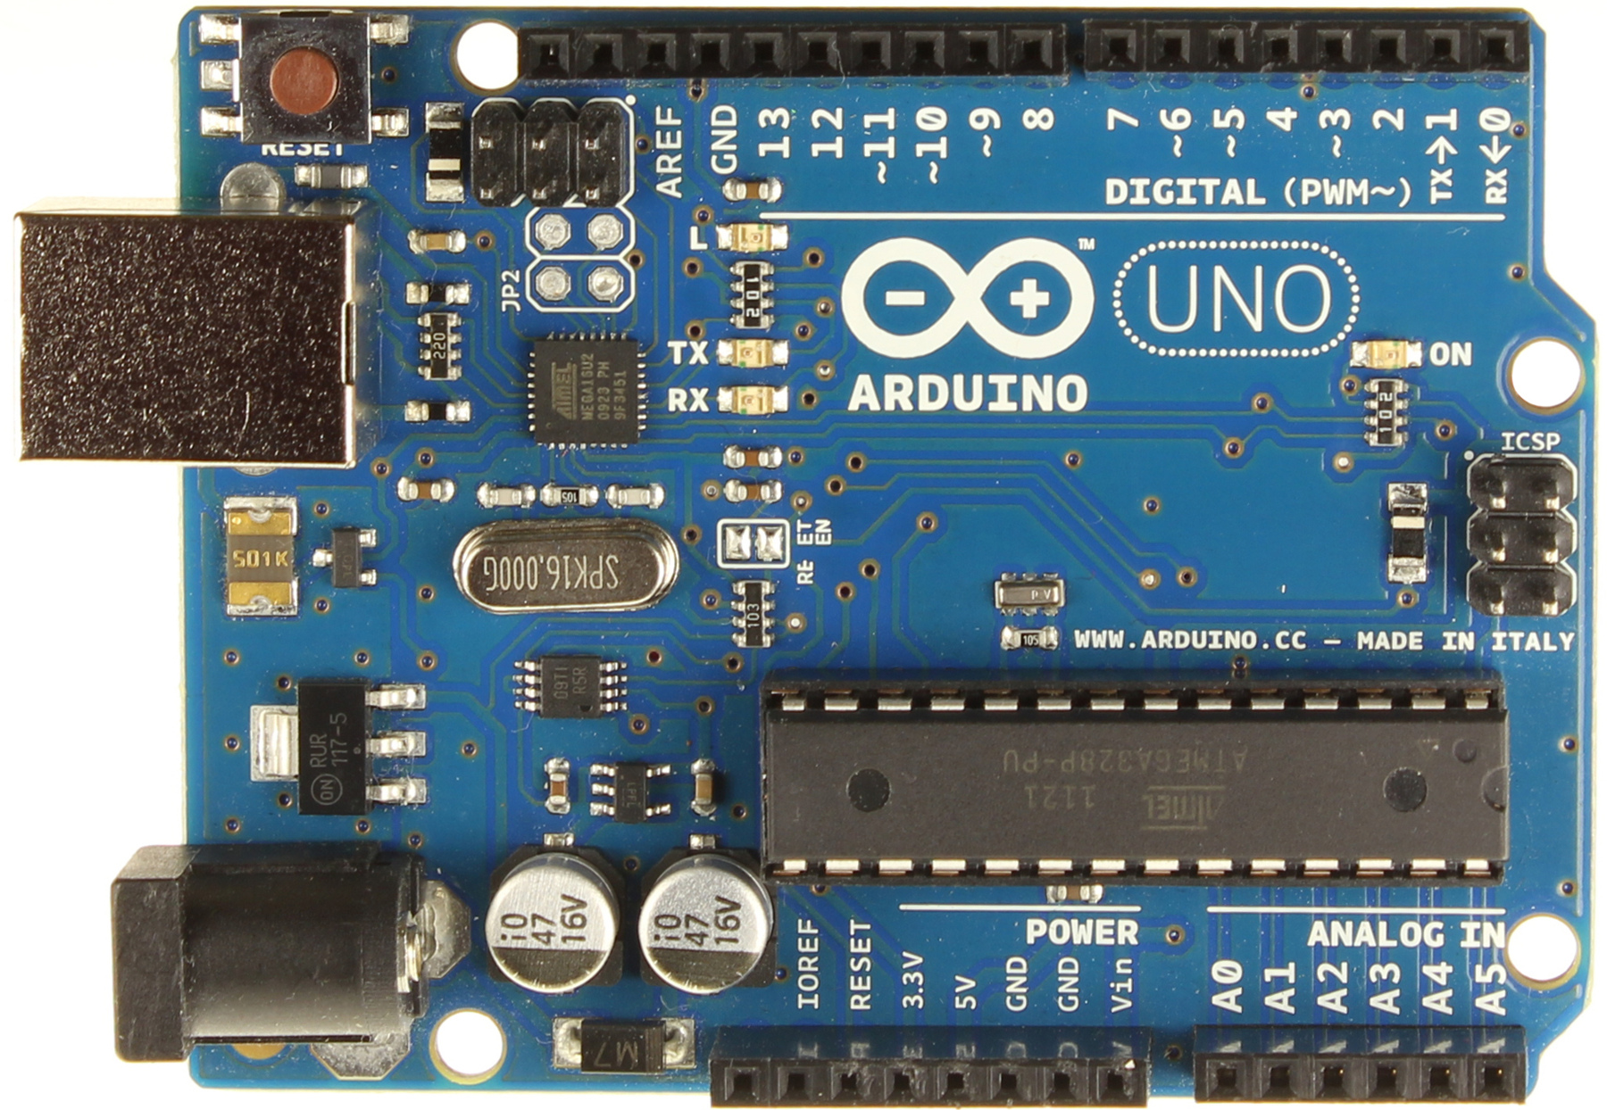
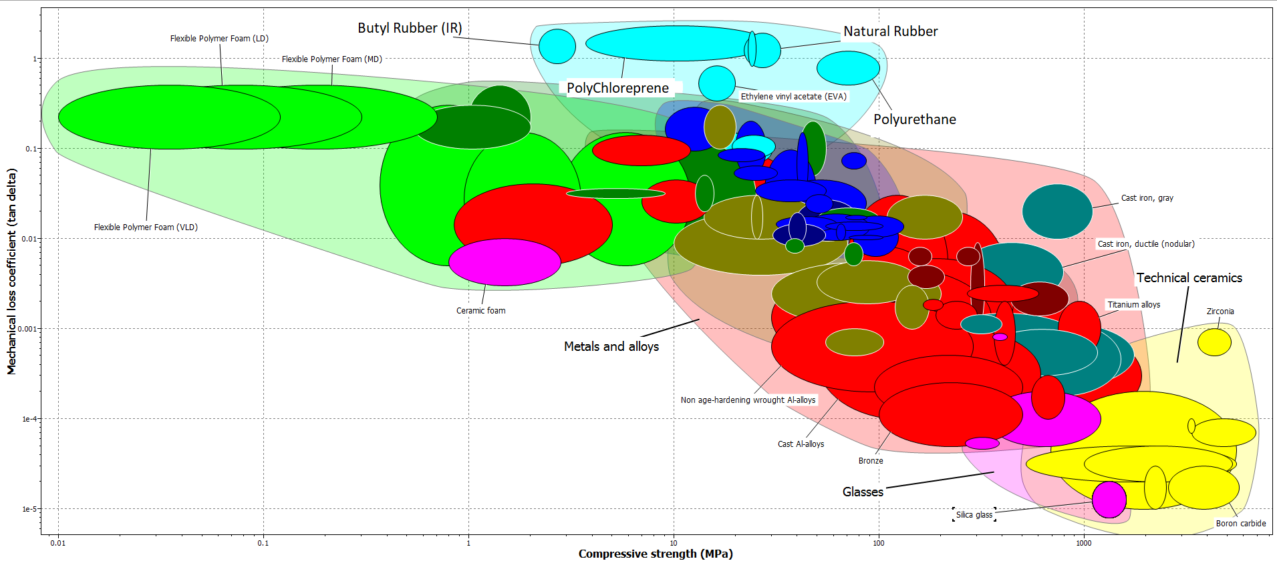
FAMU-FSU College of Engineering Noise Study
Juhil Ahir, Michael Bartoletta, Daniel Cerrutti, Jennifer Izaguirre, Amy Sirak
Sponsors: Luis Blanco and Connor Thomas
Objective
Data Collection
Trash Can Monitoring System
The objective of this project is to study noise levels within the FAMU-FSU College of Engineering
Identify spaces that have a higher concentration of noise
Engineer solutions to lessen or remove noise propagation
Improve student life and environments within the college
Using an microprocessor paired with and distance sensor, we will be able to measure trash levels in trash cans around the college. Once trash has reached a level that it needs to be emptied, an alert will be signaled to make nearby staff aware.
This shall reduce movement of noisy trashcan dollies around the building, while promoting an efficient system to keep trash deposits in the college clear.
Motivation
Our sponsors Luis and Connor, two 2018 graduates from the FAMU-FSU College of Engineering Chemistry Department, noticed a lot of noise during their time at the college that was distracting to their and their colleagues' studies. Upon graduation, they decided to sponsor this project in order to mediate this noise issue and improve the environment of the college for years to come.
Figure 3. Places students avoid studying
Figure 4. Main cause of noise
From the data collected, the area deemed as the nosiest was the 1st floor Atrium.
30% of students voiced how trashcans really bothered their studies.
Students talking within the common areas is a cultural change that’s beyond the scope of this project and not a customer requirement. Therefore, custodial staff/equipment transfer will be the main target.
Confirmed by preliminary data on decibel reader throughout the college of engineering. (Refer to figure 2)
Trash Can Dolly - Wheel Selection
Figure 6. Schematic of notification system
Future Work
Target Materials
Submit the purchase order for chosen wheels type
Compare and contrast decibels level with new wheels vs old wheels
Investigate on the most efficient alert methodology to use in the sensors.
Create a CAD design for trashcan dolly
Research on different materials for 3D printing the dolly
Search for company that allows 3D printing of big designs
Figure 1. Interior of FAMU-FSU College of Engineering
Noise Levels
Peaks are custodians moving through atrium with trash cans
Steady incline of decibel level as more students enter area
Acknowledgements
Decibel
Figure 5. Mechanical Loss vs Compressive Strength
This chart was made using the CES EduPack software at the college. It compares material properties for a wide variety of materials. We compare compressive strength to mechanical loss to see which material would be best for a weight-bearing trash can wheel while also dampening as much vibration (noise) as possible.
We would like to thank our sponsors, Luis Blanco and Connor Thomas, for their support throughout the project. We'd like to also thank our advisor Dr. Carl Moore and instructor Dr. Shayne McConomy for their guidance and support.
Time
Figure 2. Decibel levels in Atrium A

